Slide 1
Suggestions for the betterment of the organization under crucial condition.
Presentation by CS SNEA Karnataka

Slide 2
Service continuity & Improvement
Service can be made available only with
Proper Electric supply, Diesel,
Labour support ,
Land and building owners/Vendors who extends space/material/ service to ensure our service and revenue to BSNL.
Request for the management to give priority in payments for the above first.

Slide 3
Priority for Electricity bill and Diesel payments to high revenue BTS. Dattapeeta 2G and 3G site down since 10 days (today EB supply restored and switched on BTSs ) switched off dud to no EB supply and Diesel supply. It is in very high altitude and covering more villages (if 4 to 5 sites are off near to this site will manage those villages) Avarage revenue is Rs.106441 per month (june2019) and average Rs. 3500 per day. Average monthly Diesel consumption is 200 liters. For 10 days 70 liters (Rs.500) but we lost the revenue of 35000. For your kind information please.

Slide 4
Service continuity & Improvement
Migration from landline to FTTH at faster rate as maintenance cost of landline is more and service satisfaction with FTTH is high.
Informing the delay of attending the faults, personally or through SMS to the customer, will improve the confidence of the customer with BSNL and connection will be retained.
Call diversion from landline to mobile during the major or prolonged interruption will boost the confidence of the customers whose business depends on many incoming calls.

Slide 5
Service continuity & Improvement
Having MOU with builders for installing low capacity LMGs will definitely reduce the copper length and we can ensure satisfactory service and the investment on the NGN will be justified. As it is difficult to ensure the satisfactory service with existing severely damaged copper cable network for which NGN is very sensitive and not supporting for low line parameters.

Slide 6
Service continuity & Improvement
Proper counseling with customer before any disconnection. Efforts for addressing the issues before disconnection.
“Customer lost once can’t be regained”.
Regular co ordination of GM / CGM level Officers with other departments like BBMP,BWSSB, police, BESCOM , other telecom operators etc will help to avoid damages to our cables due to their works.
Outsourcing of R&M works on revenue share model will ease from huge R&M expenditure.

Slide 7
Service continuity & Improvement
Special task force well equipped with men and material will reduce the down time and improves the service satisfaction.
Mechanism for Service provision and maintenance after 18:00 Hrs and holidays in city like Bangalore is must to improve the service and to enhance the connections.
Independent nodal officer for every 500 FTTH franchise connections to monitor service maintenance and new connections to improve the service as well as revenue.
Support of OMCR and NOC after office hours to enable the field staff to restore the services.

Slide 8
Revenue Improvement
Purchase of low cost / capacity OLTEs locally and improvement of backhaul connectivity will help to penetrate more in FTTH on our own.
FTTH franchisees should be encouraged by timely payments of their revenue share as we alone BSNL difficult to meet the huge demand of FTTH in the absence of our own OLTEs at all locations and shortage of stores.

Slide 9
Revenue Improvement
Fast Provision of EB circuits on priority will definitely contribute more for our revenue. This can be achieved by extending the link on Radio modem or microwave link immediately till stable OFC media is made ready.
Every KAM of EB should be given with certain negotiable power on tariff to impress upon the corporate customers and get the lead on spot.

Slide 10
Revenue Improvement
Visit by GM level officer to corporate customers will help greatly in acquisition and retention of EB.
Ring back tone should give all the plan details of mobile services which will help customer to know the latest plans and services.

Slide 11
Revenue Improvement
As the student community is a bigger user group of DATA , special plans for students will help to acquire more customers In our fold.
Wings service can be subsidized or compliment to FTTH and EB customers customers.
Staff may be given wallet facility which improves the collection efficiency and helps customers to pay their bill at their door step .
Outstanding recoveries teams has to be increased and encouraged with incentive for fast recoveries.

Slide 12
Revenue Improvement
Immediate disposal of obsolete items with minimum formalities. Accounting of old stores and materials in ERP.
Diversion of Wi-max to other circles where it is working.
Renting out of vacant staff quarters to State / Central Govt employees with limited formalities and processing time. e.g In Hubli around 48 quarters are vacant, lost the opportunity of earning 2 lakhs per month revenue.
Rent realization from quarters which are allotted to DOT staff.
Conversion of vacant quarters in metro cities to IQs, which will earn money as well as will be maintained properly.

Slide 13
Expenditure control in areas like repair and maintenance etc.
Rationalization of Battery , power plants, Electric power sanction based on the present load will save lot. Space , energy audit.
Wrong penalty claim by Electricity authority can be saved by proper regular reconciliation.
Installation of solar panel saves in energy Bills.
AMC requirement should on actual lines working rather than equipped capacity, which needs to be scrutinized properly. Ex GSM 14.63 Cr reduced to 12.09 Cr for X part Eqpt savings 2.54 Cr and 18 lakhs for Y part equipments. Trx units 21798 reduced to 17637 by strict scrutiny by MS wing.

Slide 14
CAFs custodian must be S&M wing instead mobile service, this will help for proper collection of CAFs. penalty paid by the BSNL for the insufficient CAF details is around Rs.2,51,91,000 for Karnataka and Rs.176 crores for entire BSNL all over India for the last four years.
Details of the load
Section | Power plant | Battery | Load | Bty load | Savings of Contract demand
Mobile Section | 2000 A | 3000 AH x2 | 300 amps | 600 amps | 32 Kw
Main Exge | 2400 A | 4000 AH x 2 | 870 amps | 800 amps
STR | 500 A | 2500 AH x 2 | 280 amps | 250 shared on above
 |  |  | 1450 amps | 1650 amps

Slide 15
Expenditure control in areas like repair and maintenance etc.
Efforts for claiming the damage charges by government projects will ease us from R&M charges on our damaged cables. e.g NHAI
Encouraging to switch over to CGHS or group medical insurance from existing BSNL MRS.
Reducing the multiple store locations to utilize the free space for renting and save the security payments.
Immediate implementation of “Go Green” to all service numbers by default.

Slide 16
Expenditure control in Electrical
1 | ESCOM's Contract Demand (EB Load Reduction) | Revised Load application, Completion Report, Drawing etc., will prepare by the Electrical Wing, Concerned Exchange in charge has to coordinate with the ESCOM's to obtain the Load reduction sanction memo.
2 | Replacement of Split AC units | Exhaust Fan can be provided to reduce the Energy Expenditure.
3 | Replacement of Package AC plant | in RSU /RLU Exchanges Package AC can be replaced with Split AC to reduce the Energy Expenditure
4 | Clubbing of Battery & power plant | Where ever multiple battery & power plant are exist in the same TE Building can be clubbed made One Batter & Power plant to reduce the Energy expenditure, CMC /AMC Expenditure,
5 | UPS | Where ever UPS units are exist in the same TE Building can be clubbed made One UPS to reduce the Energy expenditure, CMC /AMC Expenditure,
6 | Utilization of Solar Pwer | Under RESCO Module Roof top Solar panel can be installed for 10 KW and above consumption of TE Buildings.
7 | Utilization of Open source power | More than 500KW consumption sites power can be purchased through open source power supplier.
8 | BTS site Cooling | In Shelter Turbo ventilator can be provided to reduce the energy Expenditure.
9 | Operation of Electromechanical service | Departmental TT/ATT cab be utilized for Operation of EMS service in major TE building to reduce O&CMC Expenditure
10 | Electricity bill payment | Payments of Electricity bills can be with in due date to reduce the late payment fee/Extra Arrears payment.

Slide 17
Improving demand generation for services and provisioning.
Informing all the location based customers around the mela holding point well before so that they can come and avail the additional services or can induct new customers. Right now we don’t have such mechanism.
Announcing customer of the mela for any new customers with small compliment will make more attractive.

Slide 18
Improving demand generation for services and provisioning.
During mela only focus is being given to SIM sales rather than landline / FTTH acquisition and demand generation.
Our own customers should be made as channel partners by extending the benefits as we extend to franchise for referring BSNL products to their known one’s and bringing the connections. Just like Amway

Slide 19
HR Changes needed for above points if any
Making transmission team to work on shift basis will definitely reduce the down time and improves the service satisfaction of the customers.
Training and posting more staff in Transmission will help for fast provision and maintenance of FTTH / EB circuits.
All the CSCs and customer interface points should be manned by staff who are well known of latest technologies/ can compare and analyze the competitors products and price, convince all type of customers. If not they are to be trained.

Slide 20
HR Changes needed for above points if any
Postings of JAOs in CSCs & Marketing .
Same way Civil and Electric staff for Bldg, Battery, Power plant and DG mtce where ever feasible.
Rotation of the work will bring the redundancy in the man power for the organization.
Motivation is the only thing available with management now, all the staff are to be given regular motivation under this crisis.
Under the present financial crisis every one from Top to bottom has to accept any responsibilities which company demands without any hesitation.

Slide 21
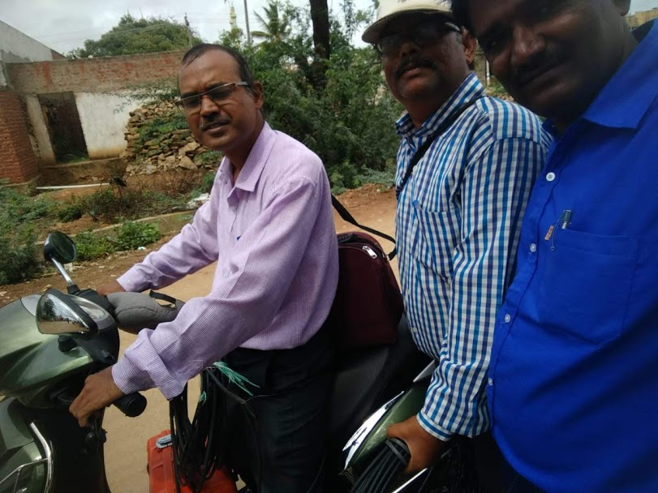
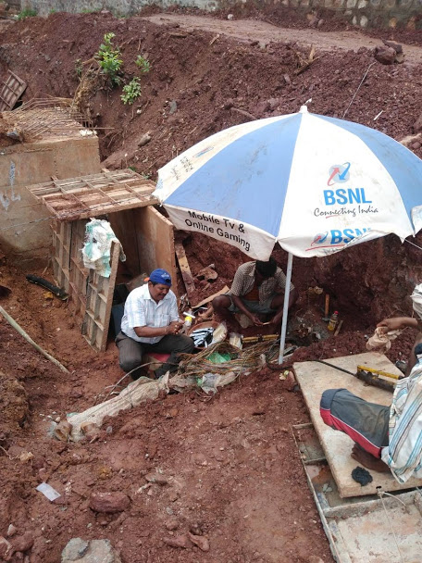
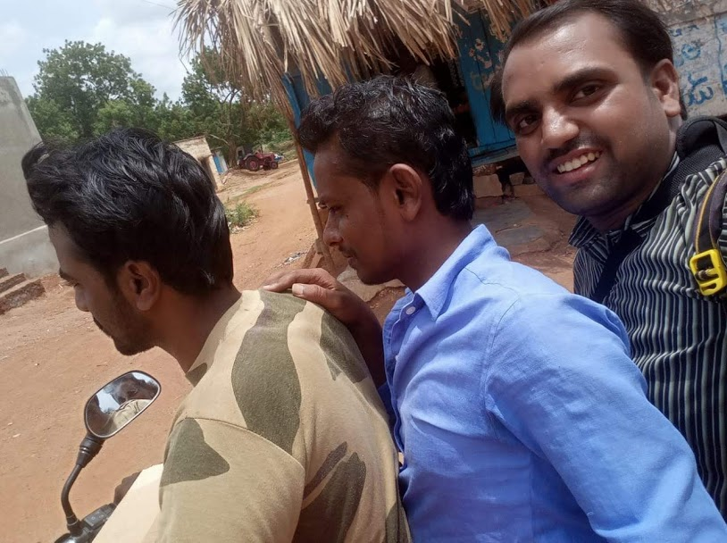
Staff attending faults without Dept vehicle

Slide 22
